Slide 1
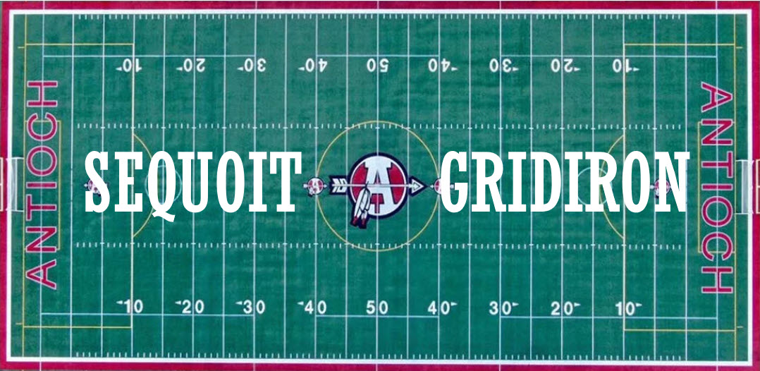
2024 Football Info Packet

Slide 2
TOPICS
Contact Info
What is the Gridiron Group?
Important Dates
Events
Parent Volunteers
Concessions
Player Fees & Registration
Fundraiser – Give Butter

Slide 3
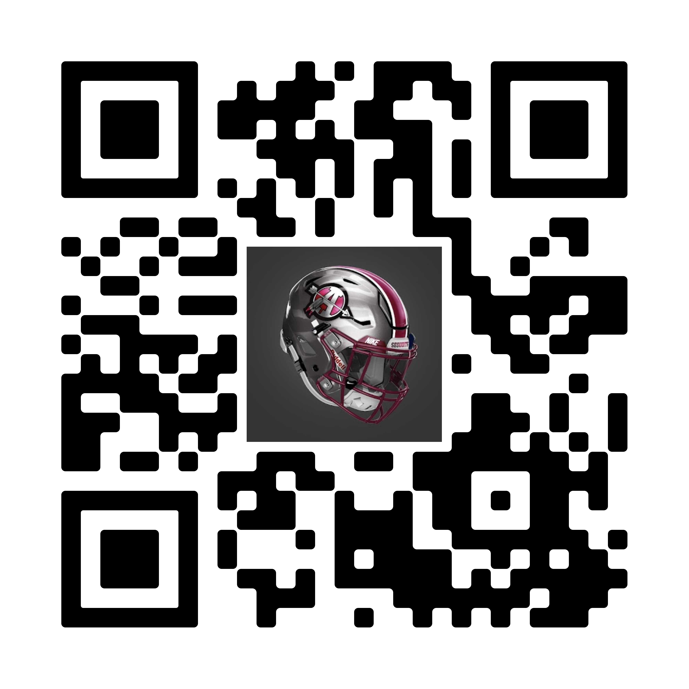
IMPORTANT CONTACT INFORMATION
Website: sequoitfootball.com
Registration information & links, calendar, sponsorship, links to media sites below, photos, records, coaches, etc
Email: Sequoigridion@gmail.com
X: @SequoitFootball
X: @SequoitGridironGroup
Facebook: Antioch Sequoits Football
Facebook: Sequoit Gridiron
Instagram: Sequoitgridiron

Slide 4
The 2024 Sequoit Gridiron Group Board Members
Meghan Marabella, President
Amanda Rivera, Vice President
Niel Patel, Treasurer
Heather Wickert, Secretary
Anne Soucheck(Cabuyadao), Technology
Mary Beth Hutling, Events Planner
Amber Campbell, Member at Large

Slide 5
WHAT IS THE GRIDIRON GROUP
The Gridiron Group is a 5013c non-for-profit group that supports the Antioch Sequoit Football Team.
The Group formally known as the “Football Mom’s” started in 1977, this is our 46th year supporting the team.
Our goal is to support the players and the coaches to ensure football is one of the best experiences players will have during their high school years
Sequoit Football is the largest club, sport or group in the school, the Gridiron Group is the only 5013c group supporting a club or sport at ACHS.
We are the only team in the NLCC conference that has a program like this, many teams have tried but have been unsuccessful.
We do our best to raise funds in the community to support the football program, we encourage each player to also raise funds for their team as well.
Newly added events that Gridiron will be volunteering at this year
Shamrock Shuffle March 16th, Chris Cagle Concert on June 13th, and Small-Town Smoke Out TBD
Notes:
We’re a non for profit group that fully supports the football program, going on our 46th year

Slide 6
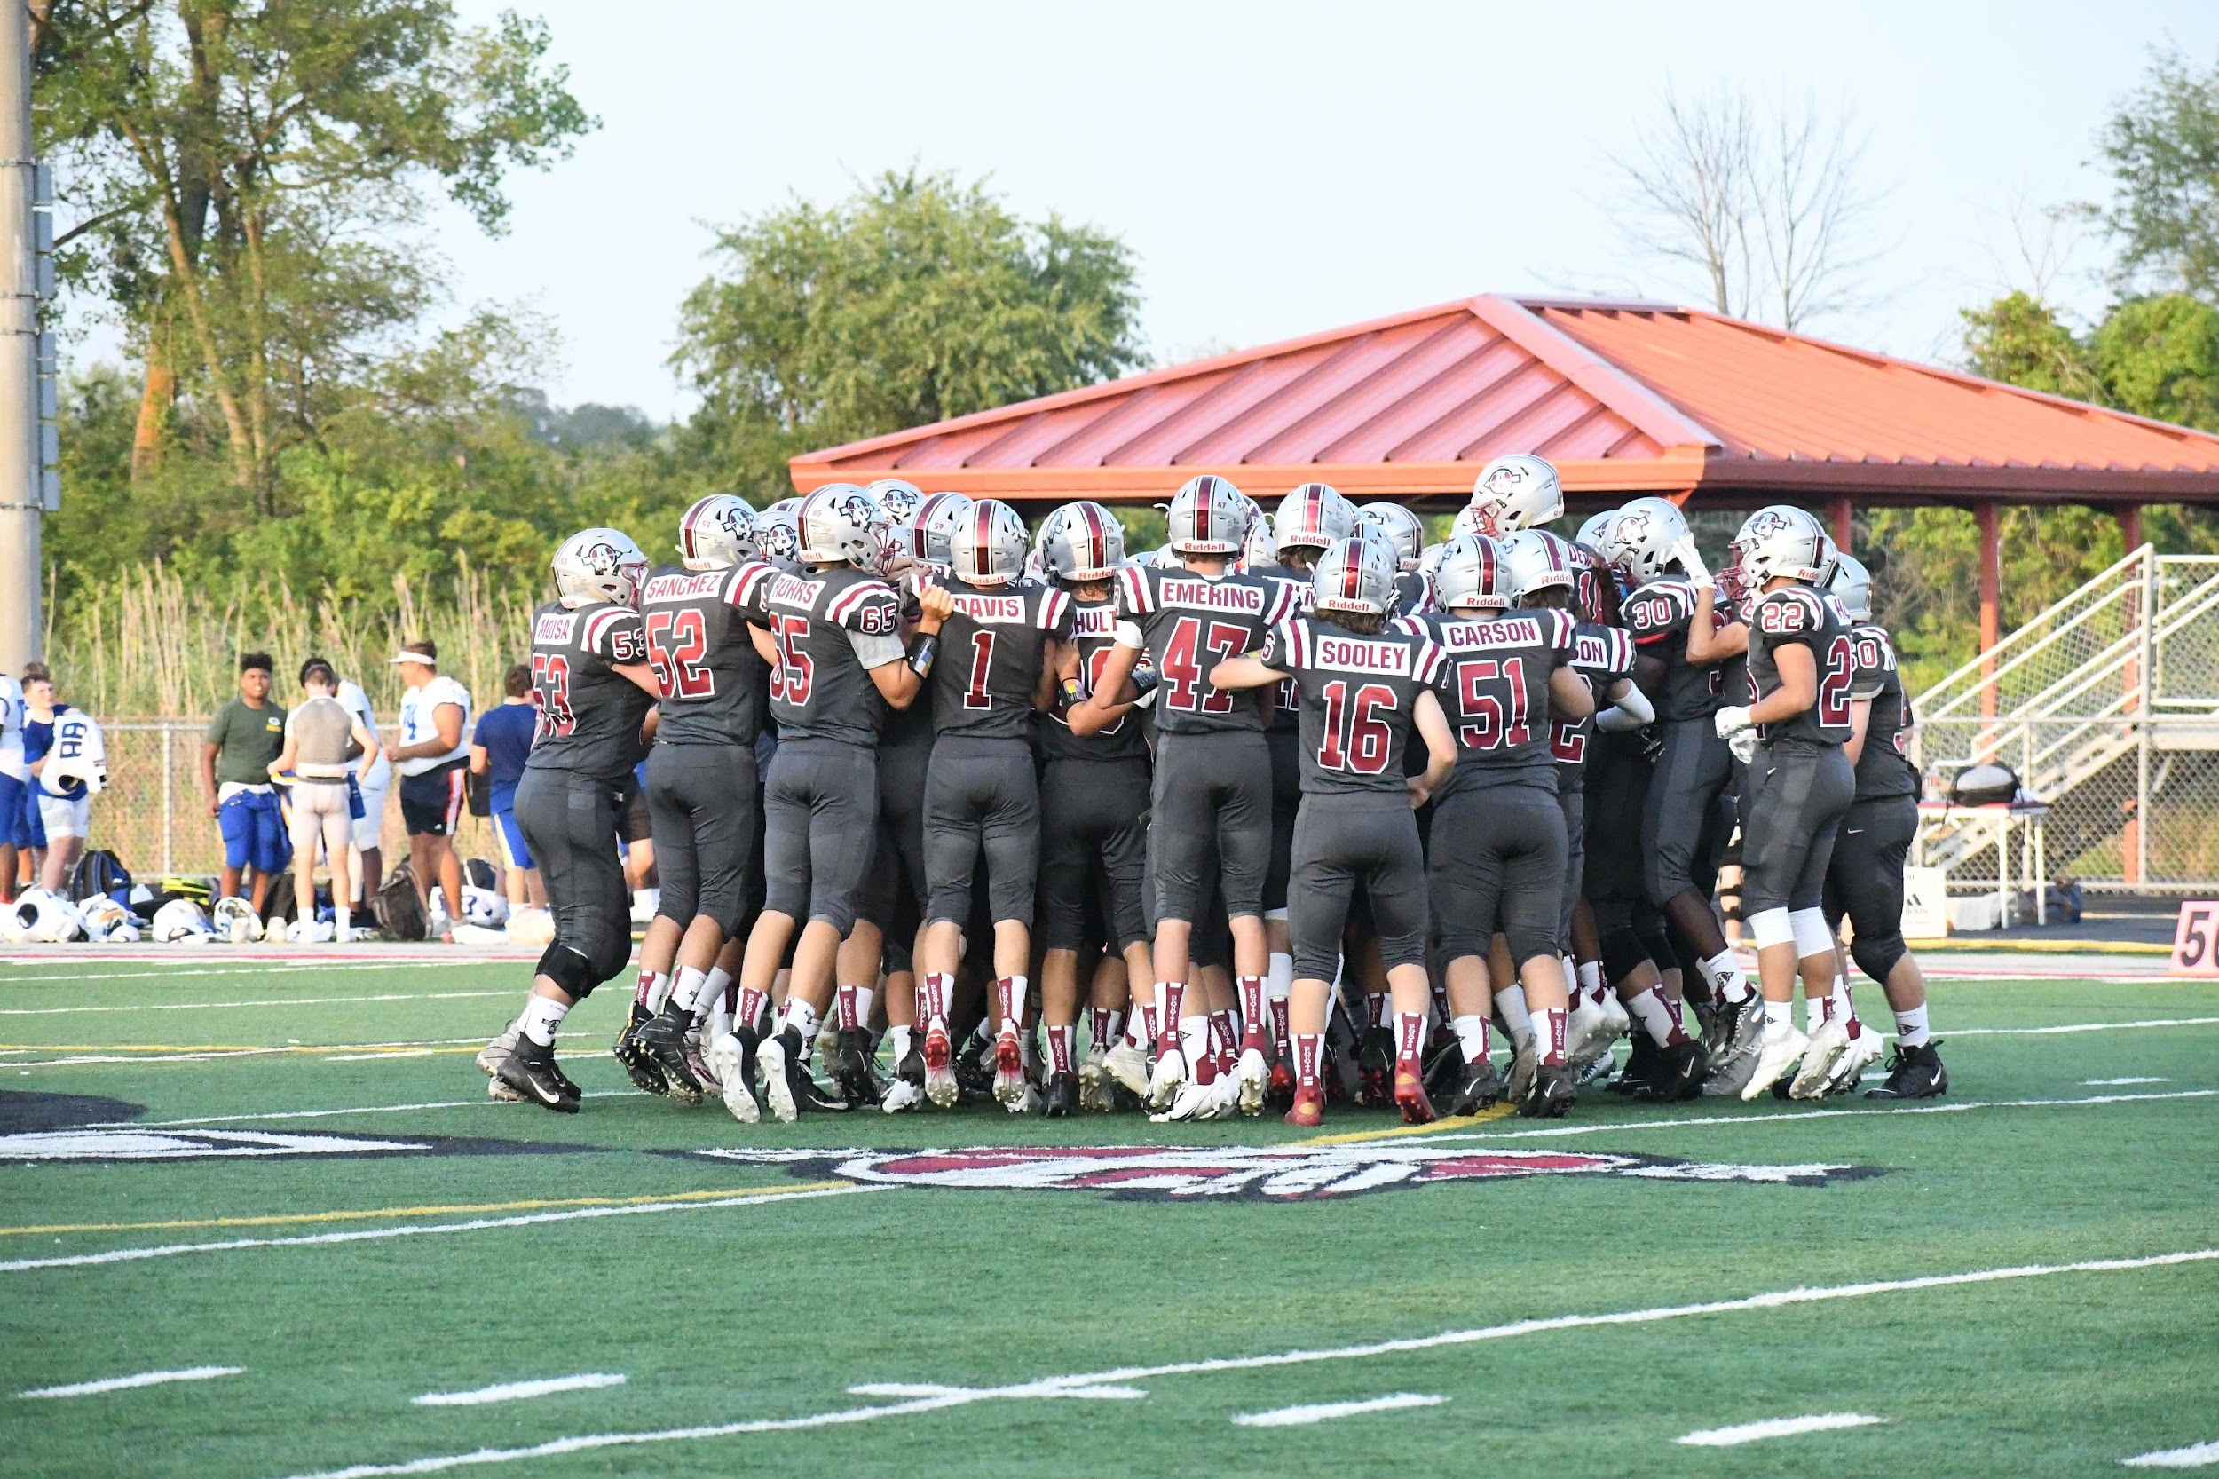
IMPORTANT DATES
Fundraiser Kick off - April 14th
Fundraiser Closes - May 31st
Camp Registration - June 1st
Camp Starts - June 3rd
Equipment Pick Up - June 10th
Varsity Paintball Outing – July 11th
Frosh Bowling Outing - July 11th
Varsity Car Wash - July 14th (Rain out Aug 17th)
Frosh Car Wash - July 27th (Rain out Aug 17th)
Gridiron Golf Outing - July 20th
Gridiron Fees Due - August 1st
Dead Week - No practice - Aug 1st - Aug 11th
First Official Day of Football Practice - August 12th
Notes:
Parent Night - April 14th
Fundraiser Kick off - April 14th
Fundraiser Closes -
Camp Fees Due -
Equipment Pick Up -
Camp Starts - June 3rd
Varsity Car Wash – July 13th or 14th
Frosh Car Wash – July 27th
Car wash rain out - August 17th
Varsity Paintball Outing - TBD
Frosh Bowling Outing - TBD
Dead Week - No practice - Aug 1st - Aug 11th
Gridiron Fees Due -
First Official Day of Football Practice - Aug 12th

Slide 7
PARENT EVENTS you DO NOT want to miss
Post Game Huddle Parent Pub Crawl
After 7x7 Games
Pub crawl t-shirt
Chris Cagle Concert
June 13th Antioch Band shell
Golf Outing
July 20th
Parent Mixer @ Sand lots of Salem
July 20th following the golf outing
Notes:
While we have an amazing group on our Board this program still needs the help from parents. We have been so lucky over the years with the most committed parents in the school.
The concession stand is a huge fundraiser for our program and we need parents every game to help with concessions – you will be seeing a sign up sheet closer to the season, it’s the expectation that at least each family in some capacity help in the concession stand once.
We are always looking for parents that want to tag along and help with our events. If you are willing to spend a day with the team at either the paintball outing, car wash or help us with the golf outing, please see me after the meeting or shoot us an email.
We are always looking for incoming freshman parents that would like to help! The freshman/sophomore team receives a snack after school. Fruit/Granola bar/water or Gatorade. This is handed out by the locker room at 3:00, the team is then given a meal after their game, before the Varsity game down by the field. If you are interested in helping with us the Gridiron Group will work with you as well as plenty of other parents in this room that have done it before so just let us know. If we don’t hear from anyone I will start recruiting Freshman/Sophomore parents in July. The Varsity team eats a full meal prior to their game at 4:00 p.m. in the cafeteria. The Gridiron Group arrives at the school at 2:30 p.m. and starts cooking, we always love having parents come and help cook and serve. This is especially great for you senior parents!
Board Member at Large – We welcome any parent that is interested in helping. This position holds no one specific responsibility but is helps in all aspects of the program. We love having the opinion and ideas of other parents so if you would like to join us please reach out.

Slide 8
Post Game Huddle

Slide 9
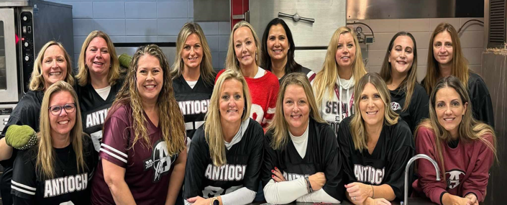
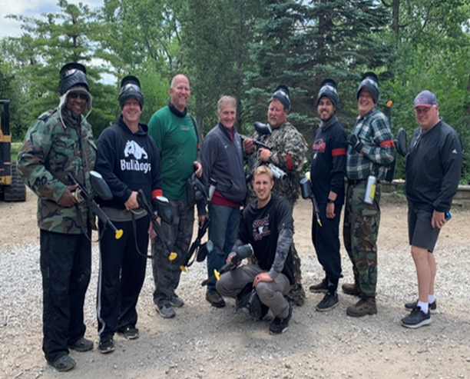
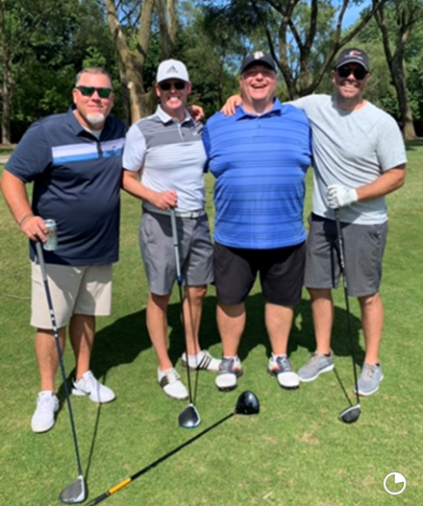
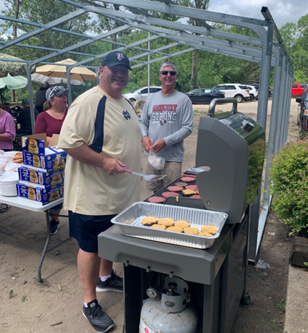
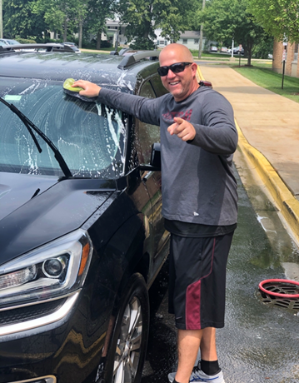
PARENT VOLUNTEERS
Concession Stand Help during Home Games
Junior parents will work the Fresh/Soph games
Freshman parents will work the Varsity games
Grill Dad’s or Mom’s
Junior parents will work the Fresh/Soph home games
Freshman parents will work the Varsity home games
Team Events
Paintballing
Golf Outing
7on7
Car Wash’s
Team Meals
Varsity Friday 3:00 p.m. at the High School cafeteria
Fresh/Soph 3:15 p.m. at the High School Pregame Snack
Fresh/Soph 7:00 p.m. Post Game meals outside stands home & away
Board Member’s At Large
No specific roll, can help in any capacity that will work for parent.
Planning/Helping with events – Homecoming, Senior Night, Golf Outing – Attend monthly meeting
Notes:
While we have an amazing group on our Board this program still needs the help from parents. We have been so lucky over the years with the most committed parents in the school.
The concession stand is a huge fundraiser for our program and we need parents every game to help with concessions – you will be seeing a sign up sheet closer to the season, it’s the expectation that at least each family in some capacity help in the concession stand once.
We are always looking for parents that want to tag along and help with our events. If you are willing to spend a day with the team at either the paintball outing, car wash or help us with the golf outing, please see me after the meeting or shoot us an email.
We are always looking for incoming freshman parents that would like to help! The freshman/sophomore team receives a snack after school. Fruit/Granola bar/water or Gatorade. This is handed out by the locker room at 3:00, the team is then given a meal after their game, before the Varsity game down by the field. If you are interested in helping with us the Gridiron Group will work with you as well as plenty of other parents in this room that have done it before so just let us know. If we don’t hear from anyone I will start recruiting Freshman/Sophomore parents in July. The Varsity team eats a full meal prior to their game at 4:00 p.m. in the cafeteria. The Gridiron Group arrives at the school at 2:30 p.m. and starts cooking, we always love having parents come and help cook and serve. This is especially great for you senior parents!
Board Member at Large – We welcome any parent that is interested in helping. This position holds no one specific responsibility but is helps in all aspects of the program. We love having the opinion and ideas of other parents so if you would like to join us please reach out.

Slide 10
Concessions & Team Meals
Concessions is very important to our program and other sports programs are chomping at the bit to take over our concessions to help their programs. If we don’t have the volunteers show up, we will lose all funds we raise working concessions
Each game we will need we will need 8 to10 volunteers for the Freshman/Sophomore Game and 8 to 10 volunteers for the Varsity game
Freshman Parents – parents will be preassigned to work a 1 concession slot for the year during the Varsity Game. If you can not work your preassigned date, please reach out the team lead to get it switched the Monday before the game.
Sophomore Parent’s – you will have the year off from concessions however we need you in areas like feeding the team, events, Homecoming, etc.
Junior Parents – parents will be preassigned to work 1 concession slot for the year during the Freshman/Sophomore game. If you can not work your preassigned it will be up to you to find a replacement.
Senior Parents – you will have the year off from concessions however we need you in areas like feeding the team, events, Homecoming, etc.
Please note you are required to show up to your assigned slot, If you can not make your preassigned date, please find a replacement and email the sequiout gridiron who

Slide 11
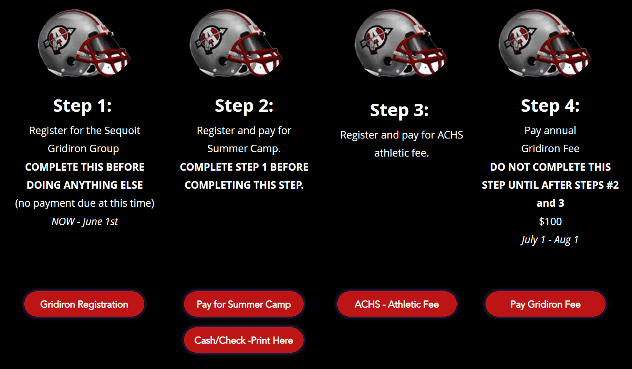
Steps for FOOTBALL REGISTRATION & FEES
Registration is located on the Sequoit Football Website under “Registration” follow and complete the 4 Step process.

Slide 12
HIGH SCHOOL FOOTBALL FEES & REGISTRATION
School Fee - $150.00
The school will send you an email when this fee is due!
Please note this is not through the Gridiron group an email will come from the school late July
Summer Camp Fee - $130.00 Due June 1st
Pay through the school using Vanco starting June 1st
Please note this is not through the Gridiron group
Gridiron Regular Season Fee - $100.00 Due August 1st
Sole income per player for the Gridiron Group. Can be paid by a check to a Board Member or on our website. www.sequoitfootball.com

Slide 13
GRIDIRON COSTS PER PLAYER EACH SEASON
7on7 Uniforms
Paintball Team Building Outings
Camp Shirts
2 Pairs of Game Socks
Name Plates on Jerseys
Playoff Shirts
Treats During Summer Practice
Weekly Team Dinners & Snacks
Helmet Stickers
Coaches Gifts
Uniform Costs & Upkeep
Chartered Busses
End of Year Player Gifts
End of Year Banquet
ROUGHLY $750.00 PER SEASON PER PLAYER

Slide 14
2024 SEQUOIT FOOTBALL FUNDRAISER

Slide 15
FUNDRAISER PARTICIPATION INCENTIVES
For Families:
If a player raises $350.00 - Camp Fee will reimbursed
If a player raises $550.00 - Camp Fee & Gridiron Fee will be covered
If a player raises $750.00 - Camp Fee, Gridiron Fee & School Fee will be covered
Buy Out Option
For those that choose not to fundraise you will have the option to “Buy Out” for $300 per player. This covers your Gridiron Fee. Link will be provided in the email with this information.
For Players:
Varsity (Jrs/Srs)
The entire team needs to participate to meet the team goal $15,000 to get their nameplate included on their game jerseys
Frosh/Soph
The entire team needs to participate to meet their team goal $15,000 to get their helmet decals to match Varsity.

Slide 16
TEAM CHALLENGE
Freshmen
Sophomore
Junior
Senior
Freshman & Sophomore Team raise $15,000
Junior & Senior Team raise a total of $15,000
Top player from each team, will get a trophy and player and parents will get exempt for any volunteering. If player raises $750, will get all fees covered.
Team winner will get a KONA ICE day after practice the first week of camp, trophy and bragging rights.

Slide 17
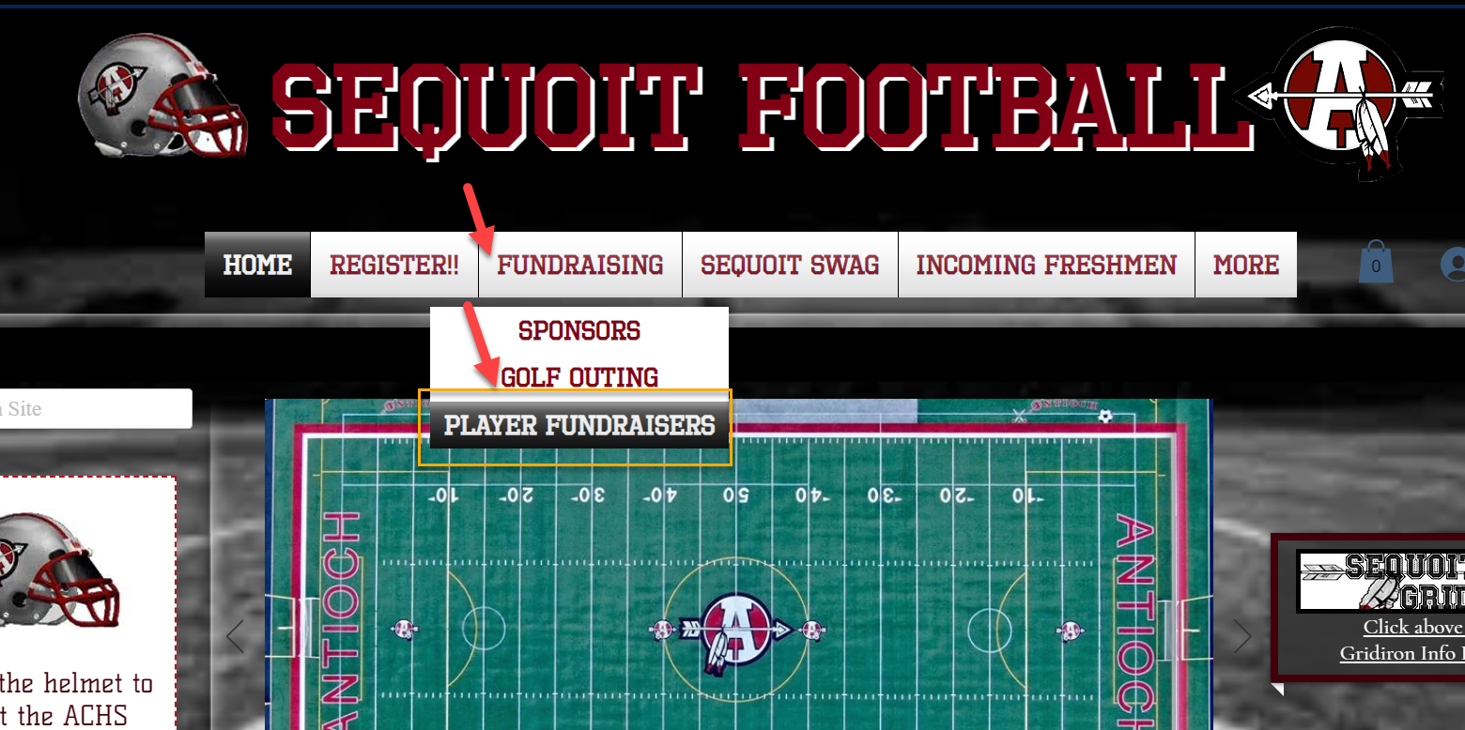
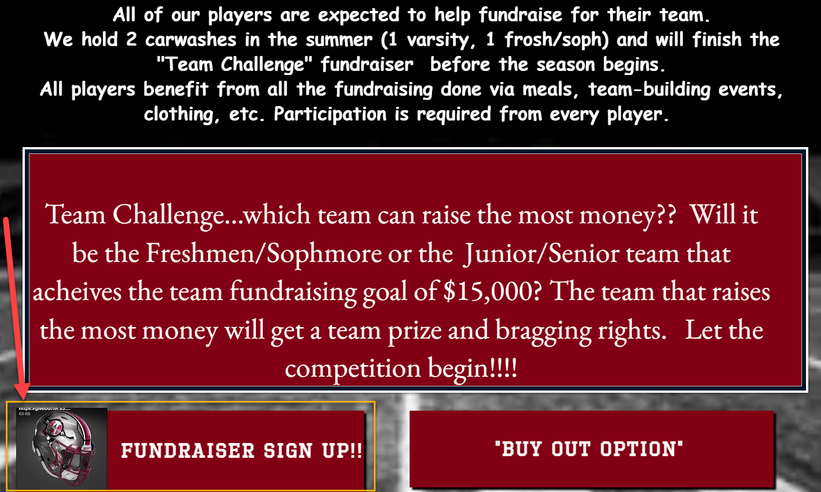
GIVE BUTTER FUNDRAISER STEPS
Step 1
Go to the Sequoit Football website, click “Fundraising”, then “Player Fundraisers” and “Fundraising Sign Up
https://givebutter.com/Sequoitfootball24

Slide 18
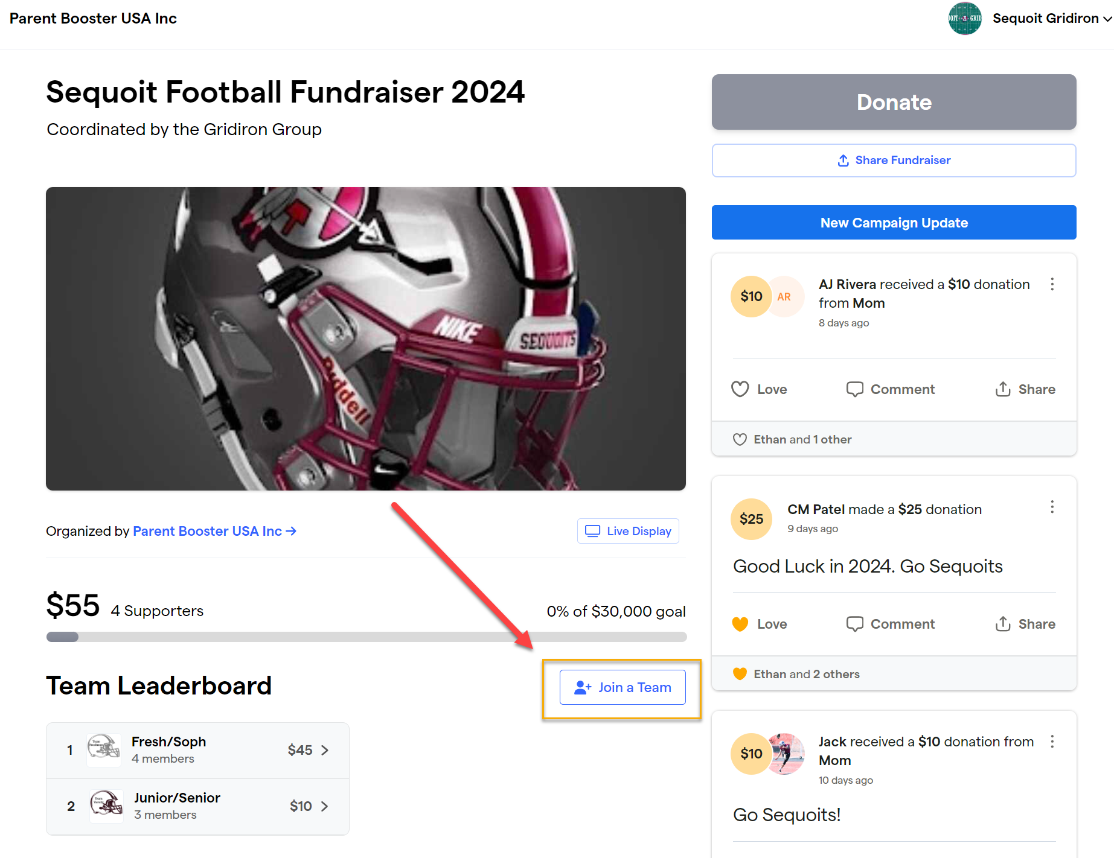
Step 2
Join a team

Slide 19
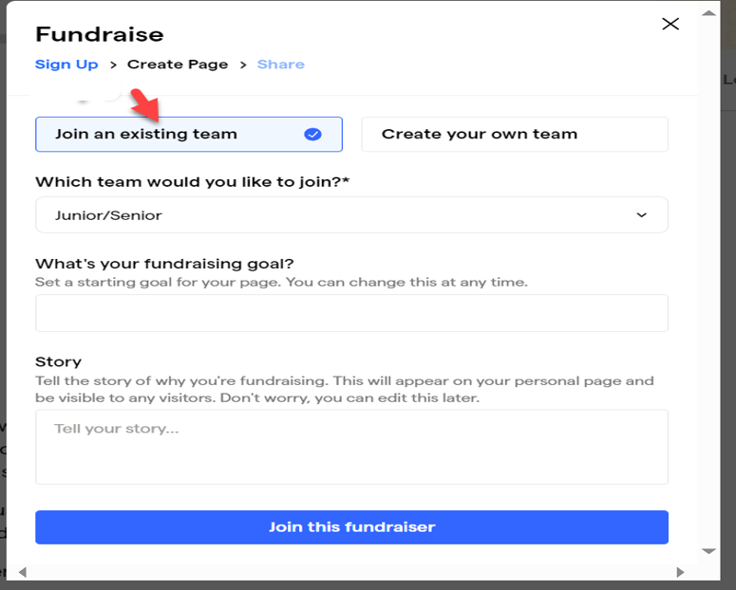
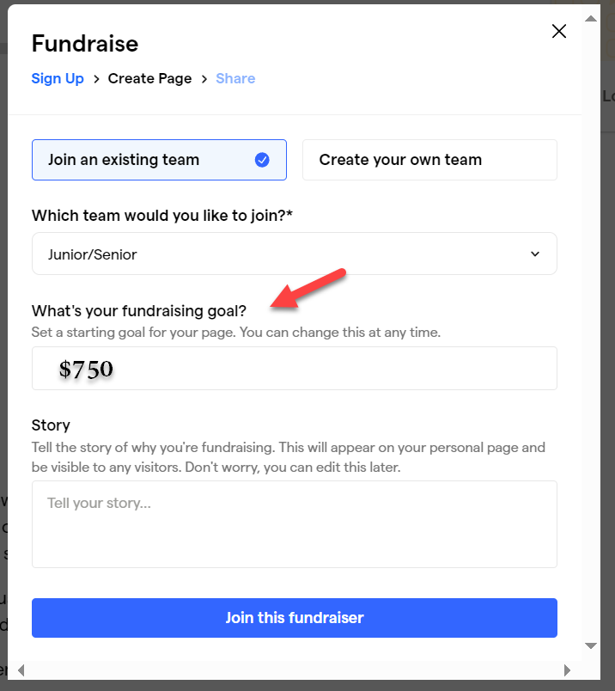
Step 3
Join existing team
Step 4
Select your team challenge Freshman/Sophomore or Junior/Senior

Slide 20
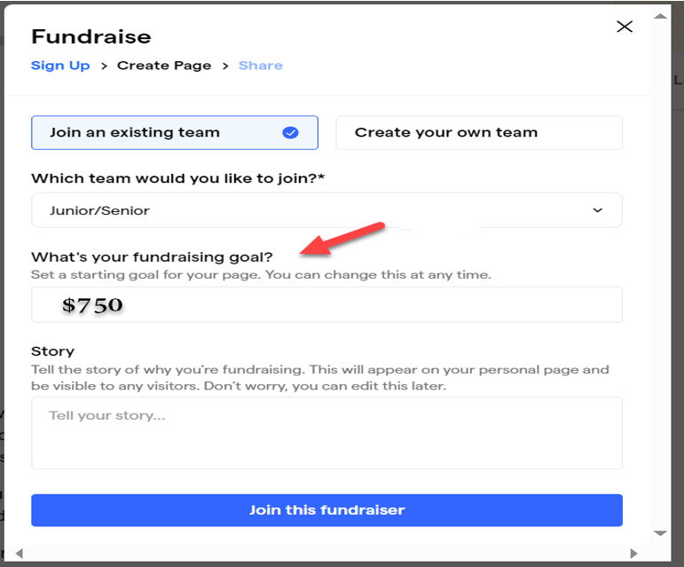
Step 5
Enter your individual fundraising amount of $750

Slide 21
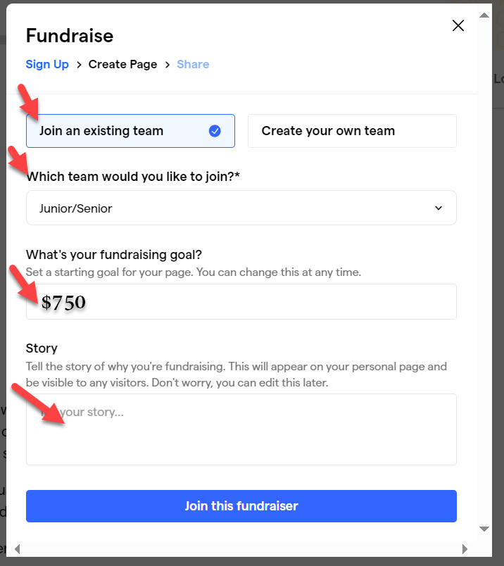
Step 6
Enter in the following information in the story to help tell why we are raising the money
“We're raising funds for our 2024 Antioch High School Football season. We need your help to reach our goal. Your contributions regardless of size, is greatly appreciated and is essential to the success of our program. Please also help share our fundraiser on social media, email, or via text with anybody you think may be willing to help. Your support is great appreciated.
Thank you, players name here

Slide 22
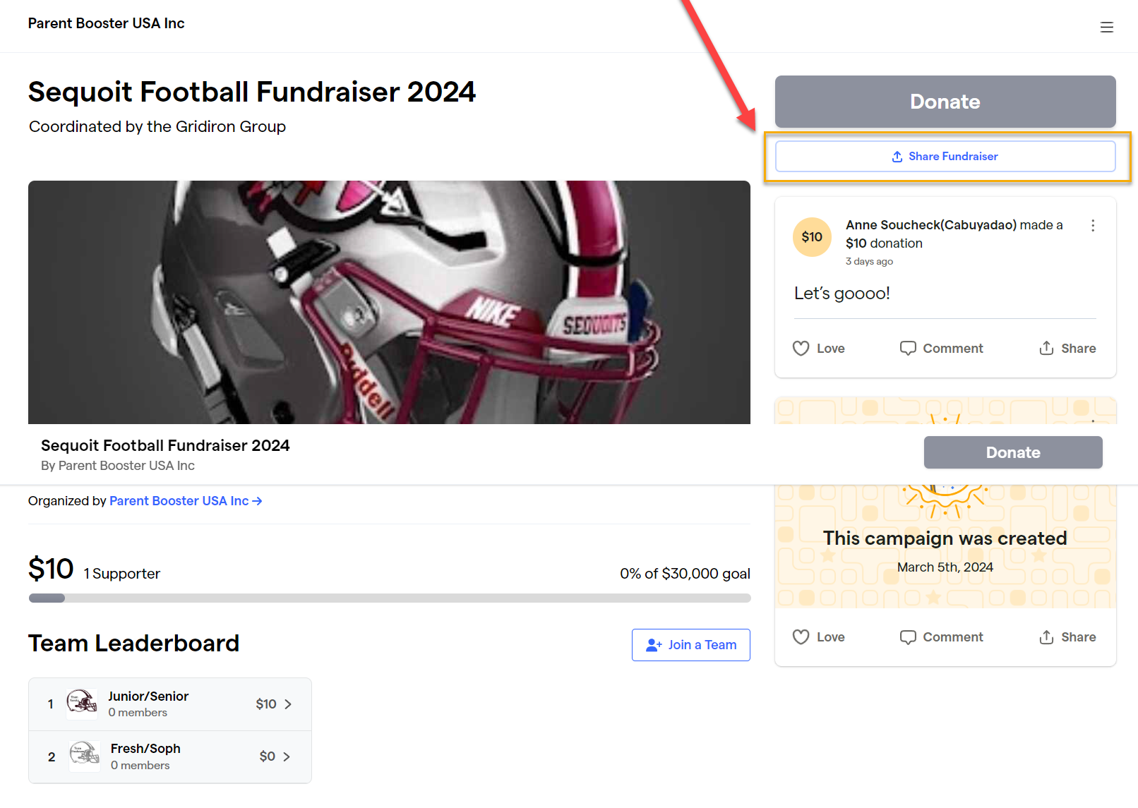
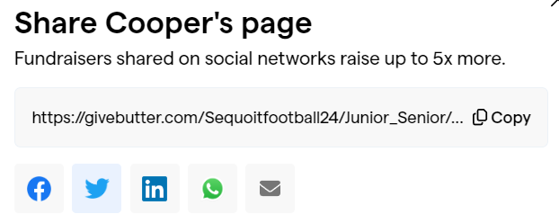
Step 7
click & share
Step 8
Share on social media by clicking Facebook, Twitter, LinkedIn or click the phone button to text or email button to email. You can also copy the link. If emailing, please make sure you email to at least 10 of your family or friends.
Don’t forget to send reminders to donate and once they donate send a Thank You email to all that donated to you!
Please reach out with questions to: sequoitgridiron@gmail.com

Slide 23
Sponsorship

Slide 24
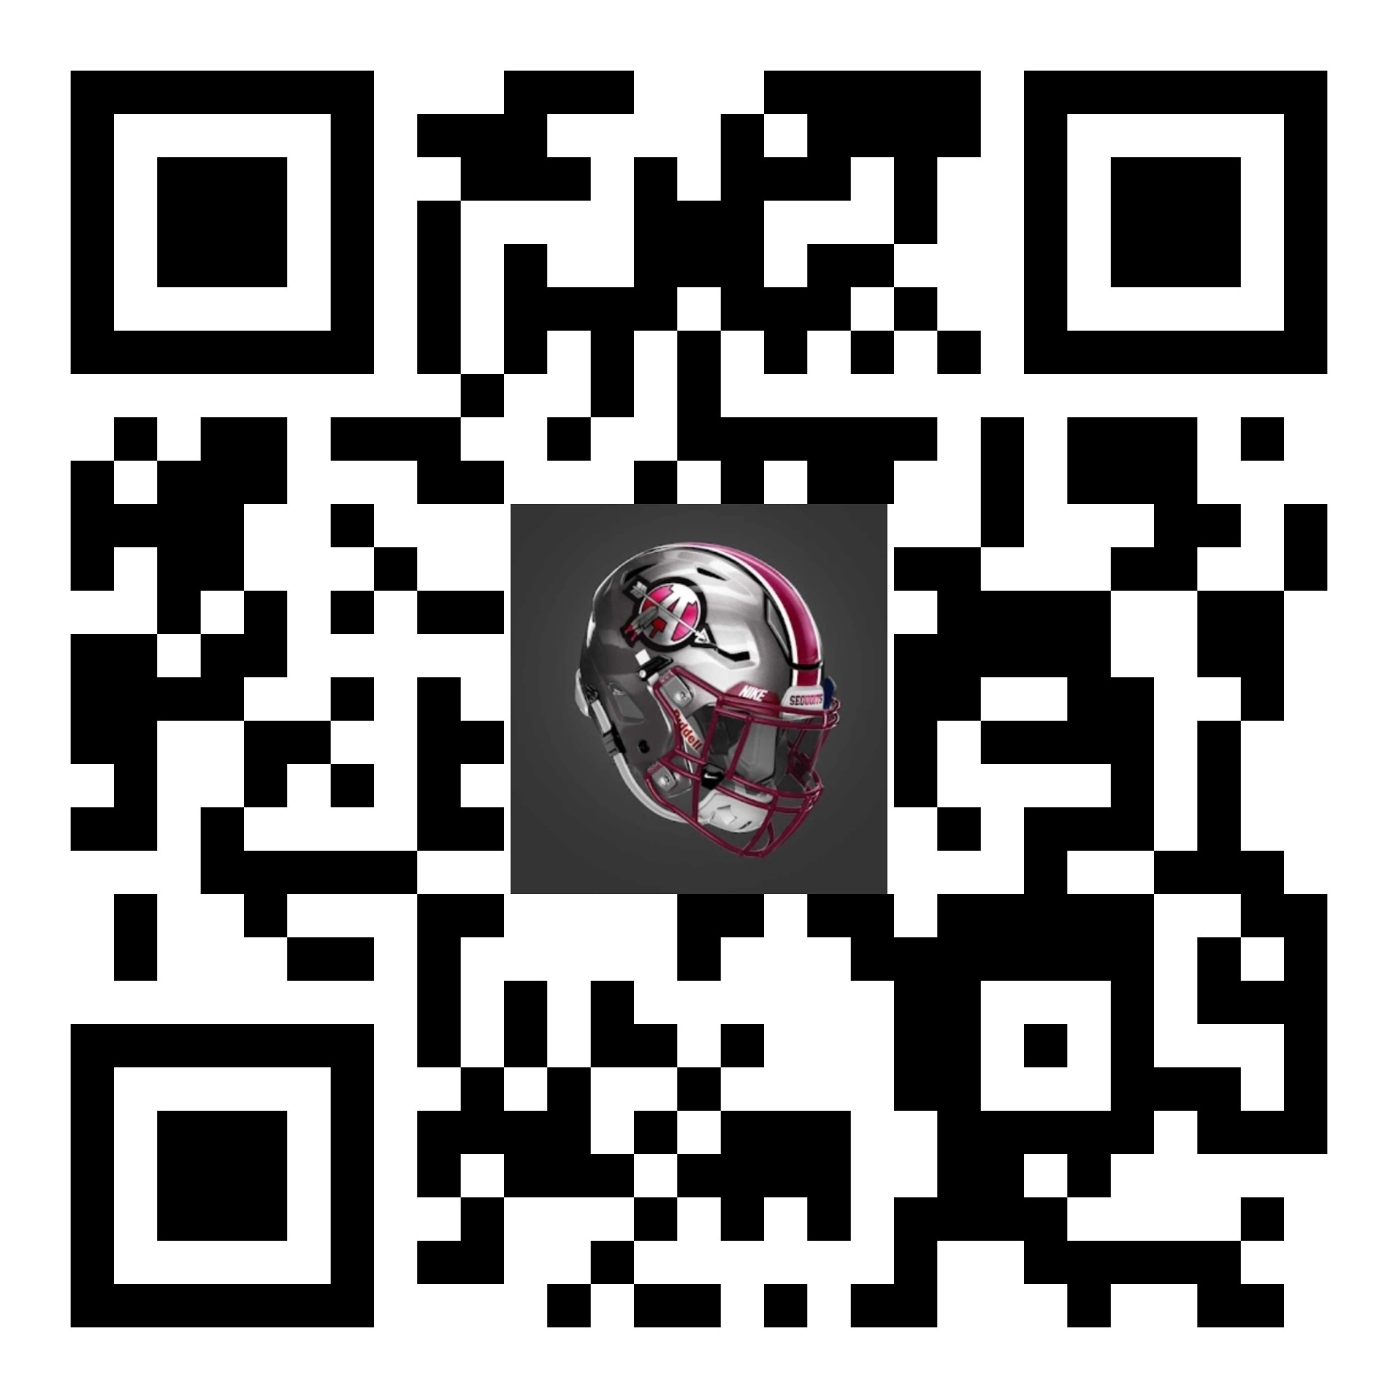
How to Sponsor . The ACHS Sequoit Gridiron Group, Inc. has been supporting the Sequoit Football Program for 46 years strong. One of the purposes of ACHS Sequoit Gridiron Group, a non-profit 501(c)(3) organization, is to fundraise money and donations; so, we can provide support to the football program, coaches, and student athletes. Support from organizations, such as yours, would mean a lot to our program and allows the ACHS Sequoit Gridiron Group to enhance the Sequoit Football Program in many ways: ● Provide meals and refreshments for summer camp, 7 on 7 games, pre & post season games for all players, managers, and coaches. ● Supplement and purchase player uniforms. ● Purchase equipment, including weight deck equipment. ● Support any student wishing to participate in football regardless of financial ability. We are currently preparing for the 2024 season which includes a conference 7x7 challenge, a fall sports scrimmage night and five home games! It is our hope that you will consider a sponsorship to the Sequoit Gridiron Group. You can sponsor or donate by two easy ways - 1. By using the following payment link by scanning the QR code or going to our Sequoit Football Website under the “Fundraising” tab called “Sponsors” www.SequoitFootball.com 2. By filling out the Sponsor form and emailing SequoitGridiron@gmail.com including your company artwork in high-resolution jpeg format. We will then arrange to come pick up your check. Please submit entries by July 1, 2024 We appreciate the sponsorship and welcome to the Sequoit family.

Slide 25
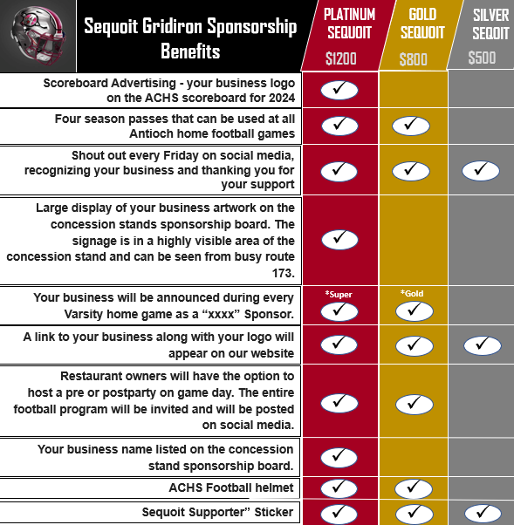

Slide 26
Football is Family
The amazing thing about football, is after awhile, you become more then a team you become brothers.
And in the stands, the crowd that gathers to cheer you on, becomes family

